Slide 1

caGrid Overview
caGrid / Novartis Workshop
Rockville, MD
June 22nd-26th , 2009

Slide 2
Agenda
General Project Overview
Component / Service Survey
Grid Interactions
Service Architecture
Deployment Concerns/Options

Slide 3

What is caBIG?
Common, widely distributed infrastructure that permits the cancer research community to focus on innovation
Shared, harmonized set of terminology, data elements, and data models that facilitate information exchange
Collection of interoperable applications developed to common standards
Cancer research data available for mining and integration

Slide 4
Driving needs: cancer Biomedical Informatics Grid
A multitude of “legacy” information systems, most of which cannot be readily shared between institutions
An absence of tools to connect different databases
An absence of common data formats
A huge and growing volume of data must be collected, analyzed, and made accessible
Few common vocabularies, making it difficult, if not impossible, to interlink diverse research and clinical results
Difficulty in identifying and accessing available resources
An absence of information infrastructure to share data within an institution, or among different institutions

Slide 5

What is caGrid?
A grid based software infrastructure consisting of services, toolkits, APIs, and applications
A production grid deployment of the core services provided by that infrastructure
A community of developers leveraging that grid and infrastructure to provide applications and services to the cancer research community

Slide 6

What is caGrid to caBIG?
The “G” in caBIG
Cancer Biomedical Informatics Grid
Provides the software foundation which underlies the tools and applications of caBIG
Analogous to the “power grid”
A multitude of applications with differing requirements can seamlessly be plugged in to a common infrastructure

Slide 7
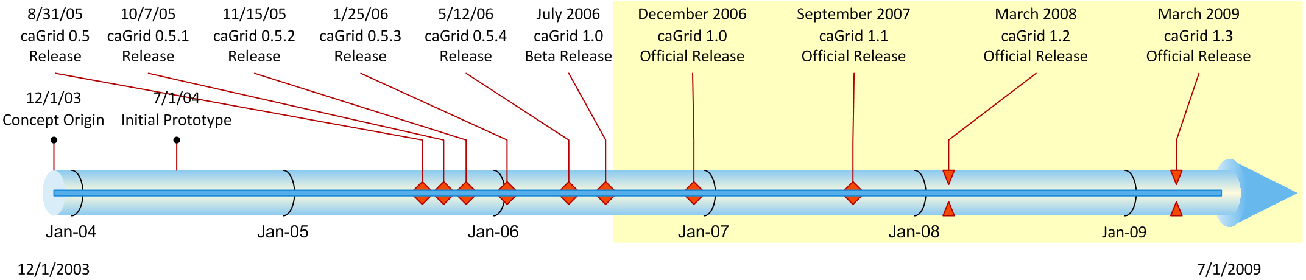
History of caGrid
Developed as the Grid toolkit for caBIG, 2004
caGrid 1.0 was a revolutionary release of the caGrid infrastructure (yellow highlight), replacing the 0.5.x test bed stream
The last release of caGrid was version 1.3, released mid March 2009
Notes:
7

Slide 8
Infrastructure Focus Areas
Leveraging Grid technologies and standards as an interoperability platform
Metadata Infrastructure
Surfacing wealth of existing caBIG data-oriented metadata on the grid
Providing new service-oriented metadata
Security
Integrating existing systems and applications with Grid security
Lowering burden of implementation of grid-wide and local policy
Service Developer Tooling
Powerful platform for bringing applications and data to the grid
Facilitating Grid wide operations
Federated query, workflow execution, resource discovery
Making the Grid more accessible
Graphical installation and configuration, higher-level object-oriented APIs, web portals, graphical administrative applications
Quality
Comprehensive testing infrastructure, automated builds and test execution on multiple platforms, dashboard with historical archive

Slide 9
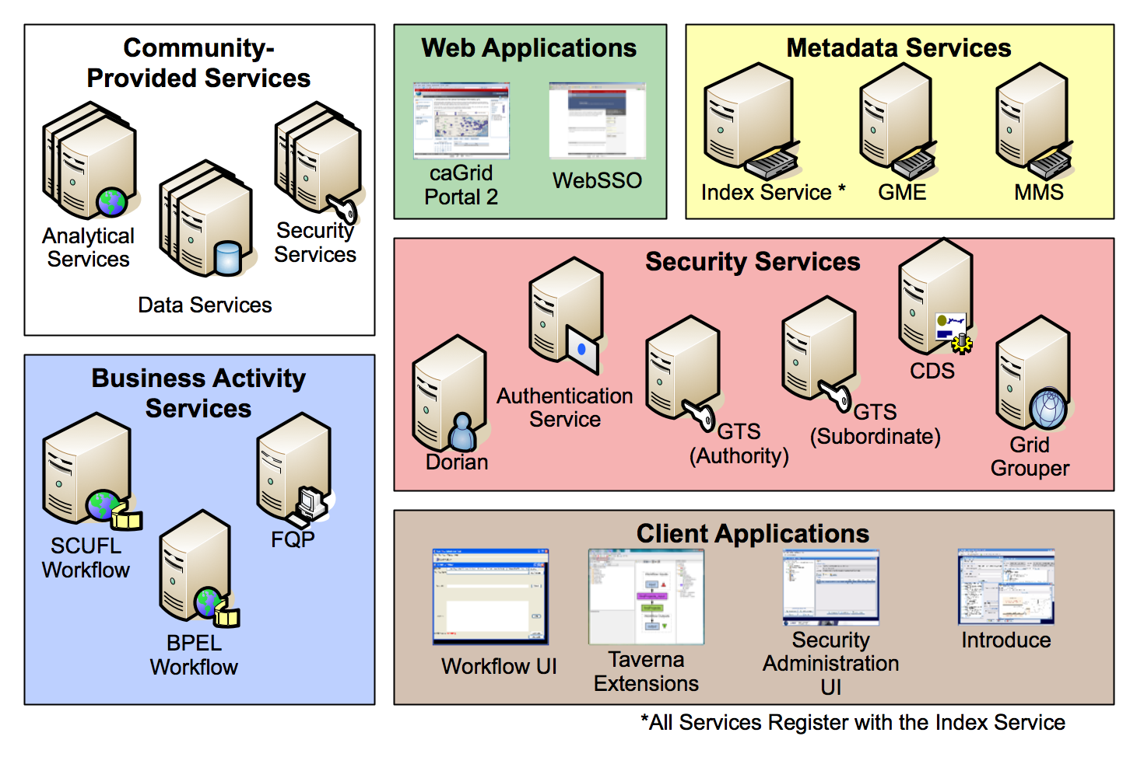
caGrid Production Environment

Slide 10
caGrid Community Involvement
caGrid itself provides no real “data” or “analysis” to caBIG™; its the enabling infrastructure which allows the community to do so
Community members add value to the grid as applications, services, and processes (for example: shared workflows)
caGrid provides the necessary core services, APIs, and tooling
The real “value” of the grid comes from bringing this information to the “end user”
Community members develop end user applications which consume of the resources provided by the grid

Slide 11
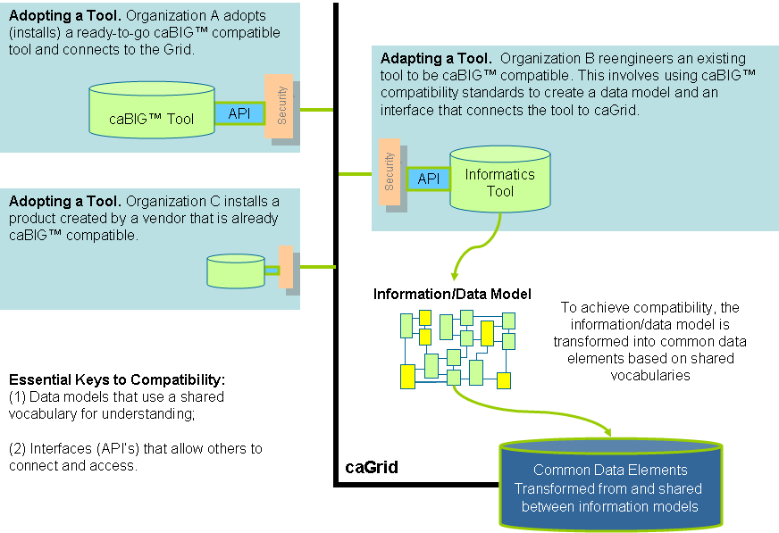
caGrid as the fabric of caBIG

Slide 12
Component / Service Survey

Slide 13
caGrid 1.3 Core Services
All caGrid Core Services were redeployed on all caBIG® Grids
(OSU Training, QA, Stage, and Production) for this release.
The (12) caGrid 1.3 Core Services are:
* New for 1.3 ** Significantly Rewritten or Enhanced for 1.3
Metadata Services | Security Services | Business Activity Services
Global Model Exchange Service** | Authentication Service** | Federated Query Processor Service**
Index Service** | Credential Delegation Service | BPEL Workflow Service
Metadata Model Service* | Dorian Service** | Taverna Workflow Service*
 | Grid Grouper Service
 | Grid Trust Service (Master & Slave)

Slide 14
Deprecated Services
During the development of caGrid 1.3, the caGrid Team issued a request for comments on, and adopted, a Deprecation Policy. For details, see: http://cagrid.org/display/caGrid13/Deprecated+Services+and+APIs
After adoption of that policy, the caGrid 1.2 caDSR, caGrid 1.2 EVS, and caGrid 1.2 GME were retired:
caGrid 1.2 caDSR Service (based on caCORE 3.1)
Replaced by the caDSR 4.0 Data Service and the new caGrid 1.3 Metadata Model Service (MMS)
caGrid 1.2 EVS Service (based on caCORE 3.1)
Superseded by EVS 4.1 Grid Service
caGrid 1.2 GME Service
Replaced by new GME service
These retired services will continue to operate until Q2 2009, when the caCORE 3.1 API is decommissioned.
While still supported in caGrid 1.3, the BDT framework is deprecated

Slide 15
Metadata Services
Metadata Model Service (MMS)
MMS is a general purpose service which acts as an adapter between existing metadata registries and caGrid
The MMS grid service provides:
Semantic Annotation of service metadata, referencing external registries
Data Service metadata generation capabilities, referencing external registries
Global Model Exchange (GME)
GME is data definition registry and exchange service that is responsible for storing and linking together data models in the form of XML schema.
The GME grid service provides:
Access to the authoritative structural representation of data types on the grid
Globus Information Services: Index Service
The Globus Information Services infrastructure provides a generic framework for aggregation of service metadata, a registry of running Grid services, and a dynamic data-generating and indexing node, suitable for use in a hierarchy or federation of services
The Index grid service provides:
Yellow and white pages for the grid

Slide 16
caGrid Data Description Infrastructure
Client and service APIs are object oriented, and operate over well-defined and curated data types
Objects are defined in UML and converted into ISO/IEC 11179 Administered Components, which are in turn registered in the Cancer Data Standards Repository (caDSR)
Object definitions draw from controlled terminology and vocabulary registered in the Enterprise Vocabulary Services (EVS), and their relationships are thus semantically described
XML serialization of objects adhere to XML schemas registered in the Global Model Exchange (GME)

Slide 17
caGrid Standard Service Metadata
All caGrid Services are expected to publish a set of standard metadata which draws heavily from the metadata registered in caDSR and EVS
Common Metadata describes generic information about service providing Cancer Center, points of contact, etc
The Service’s operations are defined and their inputs and outputs link to Classes in caDSR and semantics from EVS
Data Services additionally describe the domain Model they are exposing
Associations between classes
Semantics of the model itself

Slide 18
caGrid Advertisement and Discovery
All services register their service address and metadata information to an Index Service
The Index Service subscribes to the standardized metadata and aggregates its contents
Clients can discover services using a discovery API which facilitates query and inspection of metadata
Leveraging semantic information in EVS (from which service metadata is drawn), services can be discovered by the semantics of their data types

Slide 19
Data Service Overview
caGrid Data Services provide capability to expose data resources to the Grid
Specialization of caGrid grid services to expose data through a common query interface
Meet all base service requirements of caGrid services
Present an object view of data sources
Exposed objects are registered in caDSR and their XML representation in GME
Data Service Metadata describes information model
Queries made with CQL Query objects
Results returned as objects nested in a CQL Query Result Set
Graphical Development tool, implemented as an extension to the Introduce Toolkit, is used to create the new grid service

Slide 20
Data Service Query Language
Simple, “minimum entry” for data providers
Specifies a target object (result) type and selects the instances which satisfy the specified properties and nested object properties
Allows path navigation
Provides logical grouping
Provides name/predicate/value filtering on properties of objects
Recursively defined
Ability to return full Objects, Set of attributes, count of results, or distinct attribute values

Slide 21
Federated Query Processor
Provides a mechanism to perform basic distributed aggregations and joins of queries over multiple data services
As caGrid data services all use a uniform query language, CQL, the Federated Query Infrastructure can be used to express queries over any combination of caGrid data services
Federated queries are expressed with a query language, DCQL, which is an extension to CQL to express such concepts as joins, aggregations, and target services
Implemented as a stateful grid service, queries may be executed asynchronously and results retrieved at a later time
Supports secure deployments wherein result ownership is enforced, and queries can be executed with authorization rights of the client (via delegation)
Coupled with semantic discovery capabilities of caGrid, provides a powerful framework for data discovery, mining, and integration

Slide 22
Workflow Services
Provide capability to describe “orchestrations” of service invocations and data movement
Support for existing defacto standard language: Business Process Execution Language (BPEL)
Interoperability with other clients, editors, engines
Support for community favorite tool: Taverna (SCUFL language)
User friendly editor
Implemented as stateful grid services, workflows can be created, stopped, paused, resumed, and cancelled and results retrieved at a later time
Coupled with semantic discovery, service metadata, and registration of data type structures in caGrid, provides a powerful framework for analyzing data
Services can be dynamically discovered and federated queries can be invoked as part of a workflow

Slide 23

Introduce Vision
Become the one stop shop for grid service development
Provide a simple, yet powerful, graphical user interface (GUI) to encapsulate complexities of grid service development
Provide an extensible toolkit with which grid services can be created and modified programmatically

Slide 24
Introduce Overview
A framework which enables fast and easy creation of Globus based grid services
Provide easy to use graphical service authoring tool.
Hide all “grid-ness” from the developer
Utilize best practice layered grid service architecture
Integration with other core grid services and architecture components
GAARDS Security Infrastructure
Globus Index Service
Global Model Exchange
Metadata Model Service
Cancer Data Standards Repository
Extension Framework for integrating with other architecture components

Slide 25
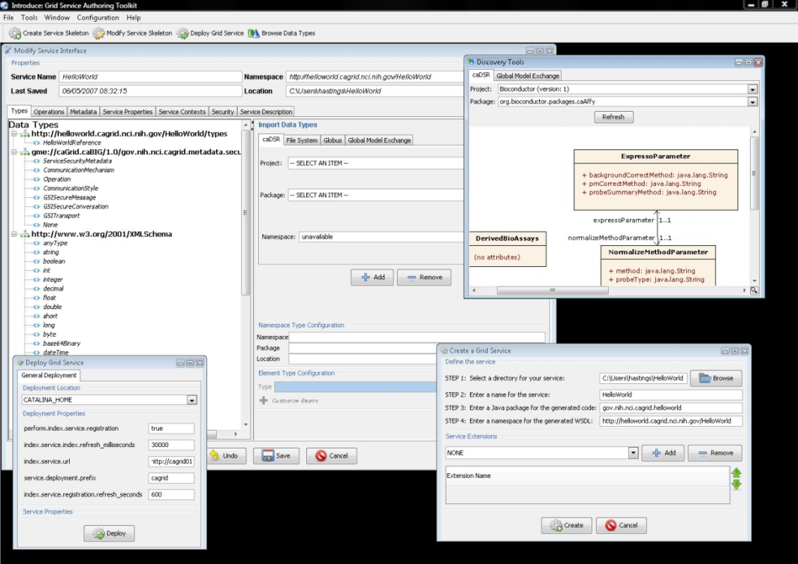
Introduce Features
Supports modification of operations
Adding operations
Removing Operations
Updating Operations
Importing Operations
Graphical Configuration
Advertisement
Security
Service Metadata Specification
Service Metadata Editing
Service Configuration Properties
Auto Generates Code for Service
Auto generates a client API for service.
Graphical Deployment of Service
Globus
Tomcat
JBoss

Slide 26




An example service development process (0 lines of developer code)
Create Semantically Harmonized Data Model
Generate
Data Resource
Grid-ify

Slide 27
GAARDS Overview
Grid Authentication and Authorization with Reliably Distributed Services (GAARDS)
GAARDS provides services and tools for the administration and enforcement of security policy in an enterprise Grid.
Developed on top of the Globus Toolkit
Extends the Grid Security Infrastructure (GSI)
Provide enterprise services and administrative tools for:
Grid User Management
Identity Federation
Trust management
Group/VO management
Access Control Policy management and enforcement
Integration between existing security domains and the grid security domain
Delegation
Web Application integration

Slide 28
GAARDS Components
Dorian
Grid User and Host Account Management
Integration point between external security domains and the grid
Allows accounts managed in external domains to be federated and managed in the grid
Dorian allows users to use their existing credentials (external to the grid) to authenticate to the grid
Grid Trust Service (GTS)
Creation and Management of a federated trust fabric
Supports applications and services in deciding whether or not signers of digital credentials/user attributes can be trusted
Supports the provisioning of trusted certificate authorities and corresponding CRLS
Grid Grouper
Group management service for the grid
Provides a group-based authorization solution for the Grid
Enforce authorization policy based on membership to groups

Slide 29
GAARDS Components cont.
Authentication Service
Integrates existing credentials providers into the grid
Provides a uniform grid interface for authenticating to existing credential providers
Applications can communicate with any credential provider
Credential Delegation Service (CDS)
Enables users/services (delegator) to delegate their Grid credentials to other users/services (delegatee) such that the delegatee(s) may act on the delegator's behalf
Extendible delegation policies
Auditing support
Web Single Sign-On (WebSSO)
Provide “Single Sign-On” capabilities for web applications which interact with the grid
Leverage grid credentials for authentication
Allows web applications to invoke grid services on the user’s behalf

Slide 30
GAARDS Components cont.
Common Security Module (CSM)
Provides a centralize approach to managing and enforcing access control policy authorization
Security Metadata
Ensures communication interoperability between grid services

Slide 31
Grid Interactions

Slide 32
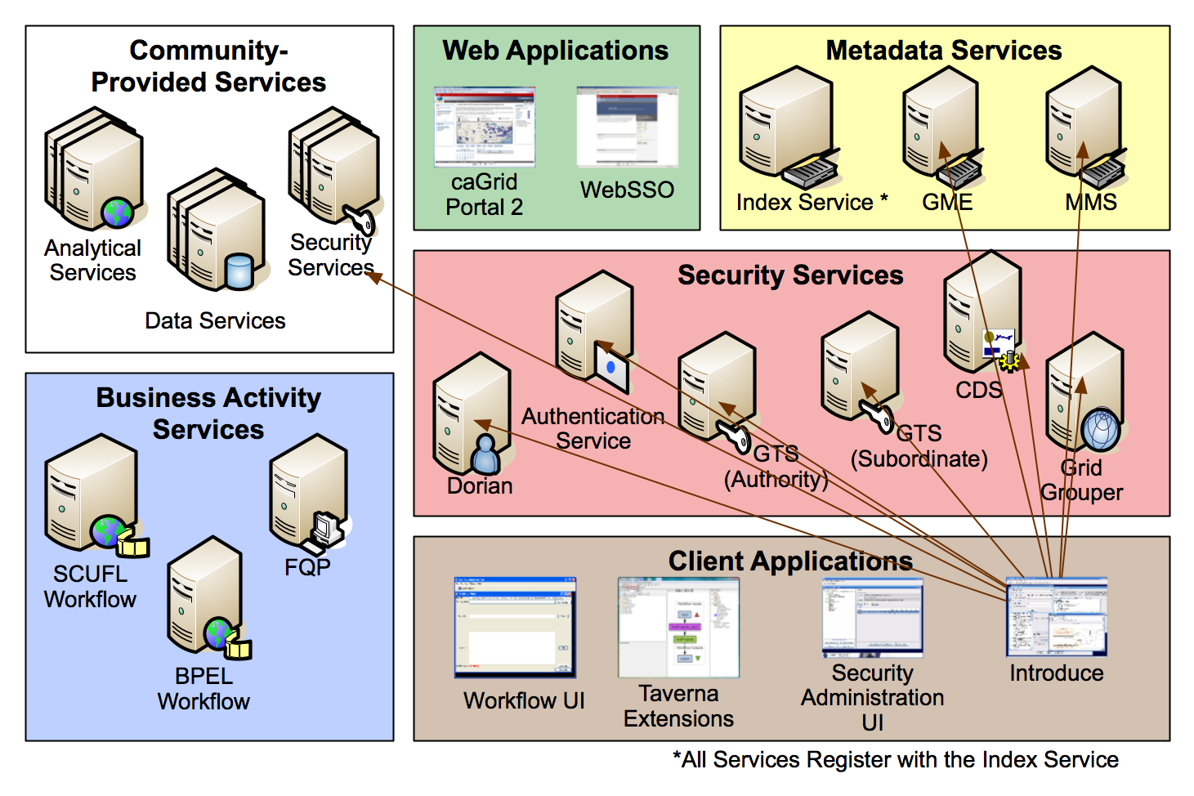
Introduce Grid Usage

Slide 33
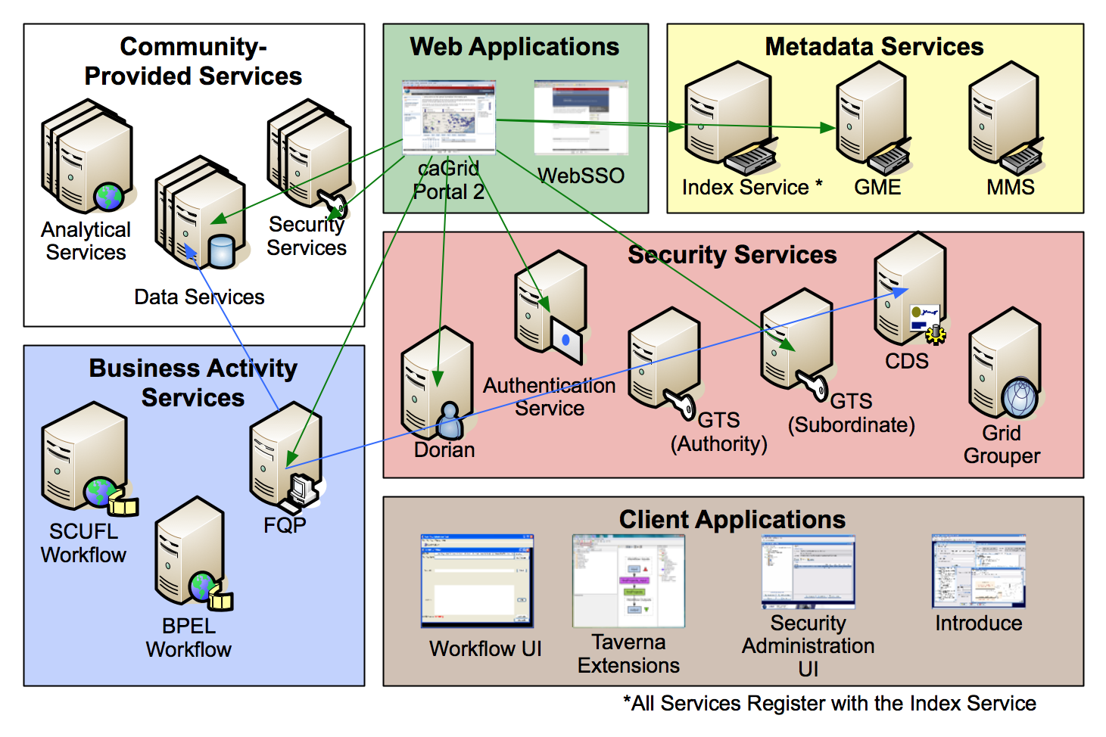
caGrid Portal Grid Usage

Slide 34

GAARDS Grid Usage

Slide 35
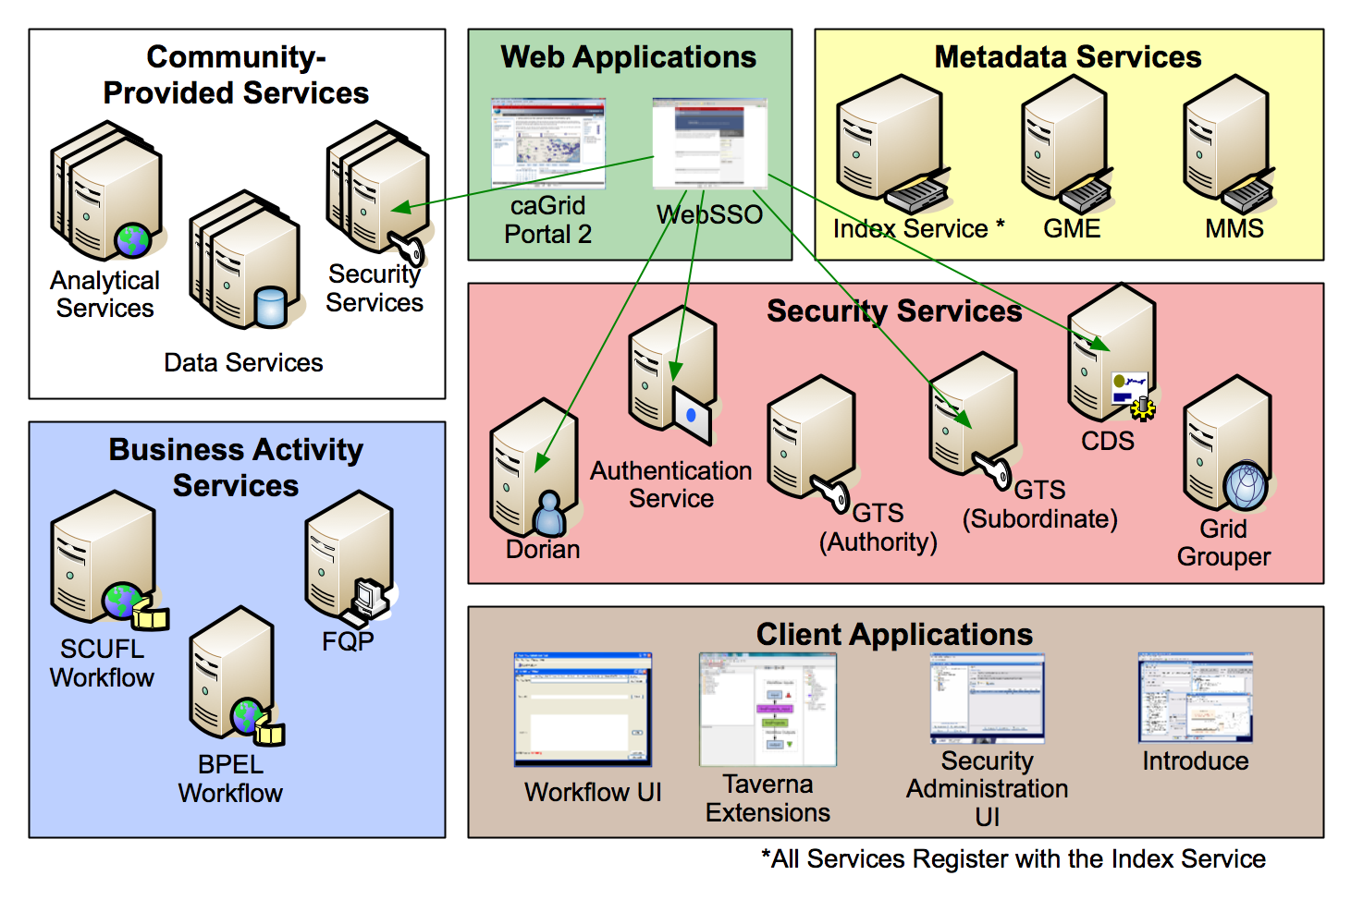
WebSSO Grid Usage

Slide 36
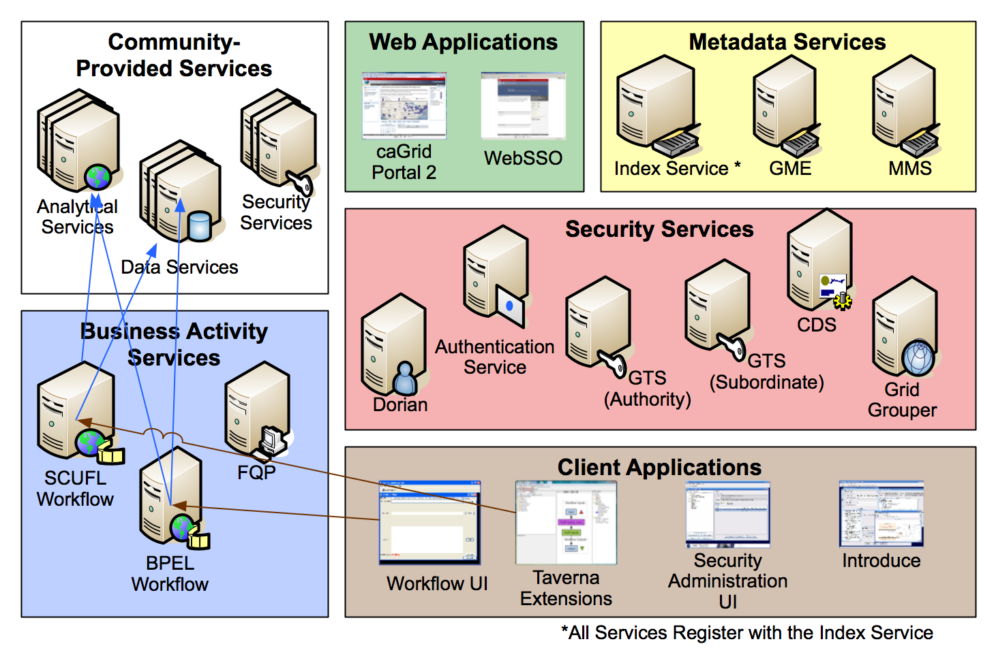
Workflow Interactions

Slide 37
Service Architecture / Build Details

Slide 38
Service Layers

Slide 39
Service Layers: caBIO Data Service example
Introduce-managed Security constraints
GTS-managed Trusted Authorities
CSM/Grid Grouper Authorization
Common Data Service Operations (WSDL)
CQL, CQLResult, Data Service Faults (XSD)
caBIO Schemas (XSD)
caGrid Metadata Schemas (XSD)
WS-Enumeration Operations and Types (WSDL, XSD)
Introduce-generated ServiceMetadata
Introduce-generated DomainModel
Introduce-provided common operation implementations (Resource Property, Security Metadata)
caGrid-provided CQL implementation to query ApplicationService
Introduce managed configuration points:
Index Service Location
Data Service Component Implementations (CQL Processor, Validators)
ApplicationService Information
Other options
Introduce-generated code to manage service group registration and maintenance
Introduce-generated Resource to manage metadata
Introduce-generated Resources to manage enumerations

Slide 40
caGrid Projects
caGrid is organized as three distributions/products:
Core
Portal
Workflow Client
caGrid core is organized as numerous (~60) independent projects
http://cagrid.org/display/caGrid13/caGrid+Projects+Introduction
Each project can be used stand alone (e.g. GAARDS UI)

Slide 41
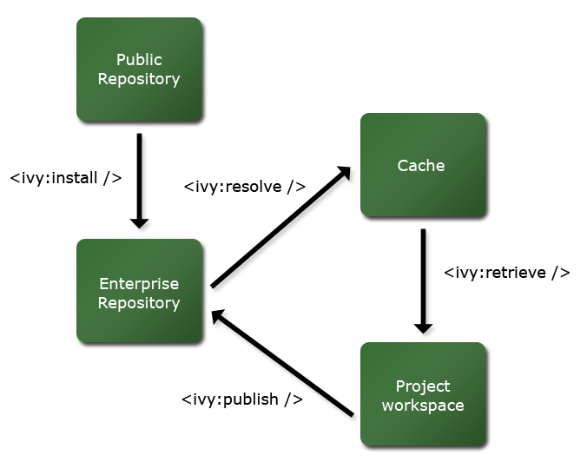
caGrid Ivy Build
caGrid release directory contains an Enterprise Repository for all external dependencies
caGrid build process resolves against this repository, and publishes to an integration repository
Releases will publish the integration repository and Enterprise Repository to a publicly accessible location
External projects/components can depend on a local caGrid integration and Enterprise Repository, or the remote publicly accessible one

Slide 42
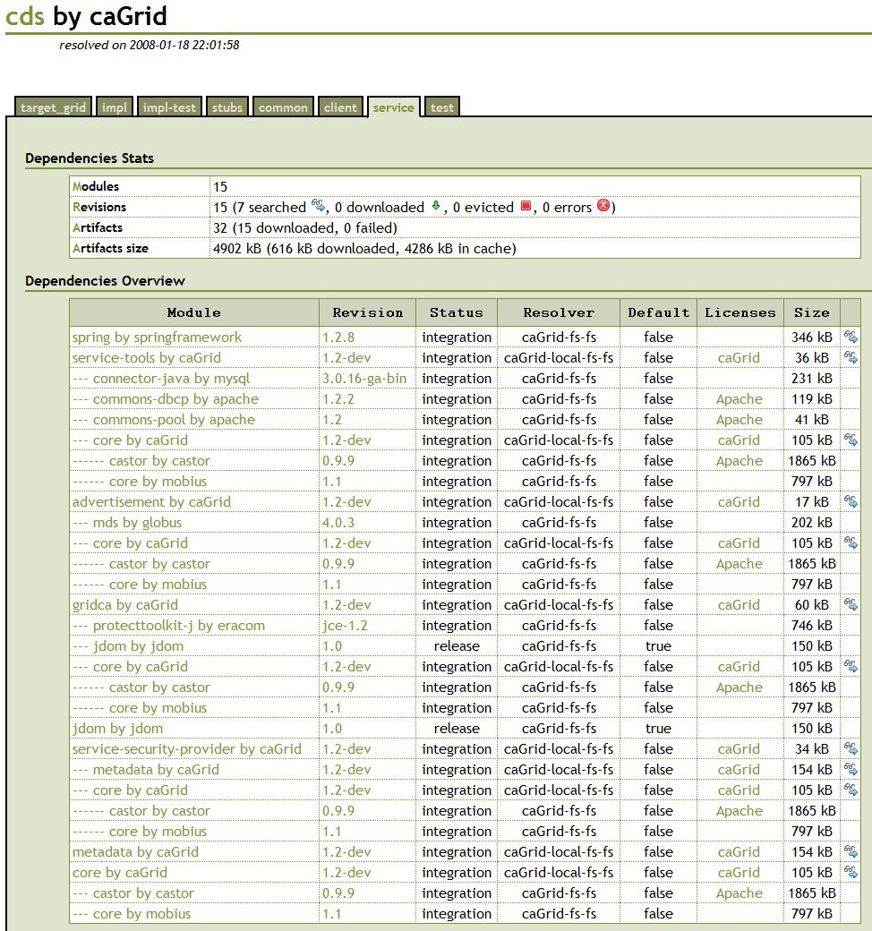
caGrid Ivy Build cont.
Transitive dependencies are formally managed
Supporting multiple configurations and version constraints
Configurable conflict management
Detailed dependencies reports are generated

Slide 43
caGrid Ivy Example Usage
What jars do I need to use the Dorian client API?
Just define the dependency:
<dependency org="caGrid" name=“dorian“ rev=“1.2" conf=“*->client"/>
Tell Ivy where to copy it:
<ivy:retrieve pattern=“lib/[originalname](.[ext])" sync="true" />
Everything you need will be copied where you want it
Tutorial available:
http://cagrid.org/display/knowledgebase/Use+caGrid+Libraries+in+Your+Application (http://cagrid.org/x/EoMs)

Slide 44
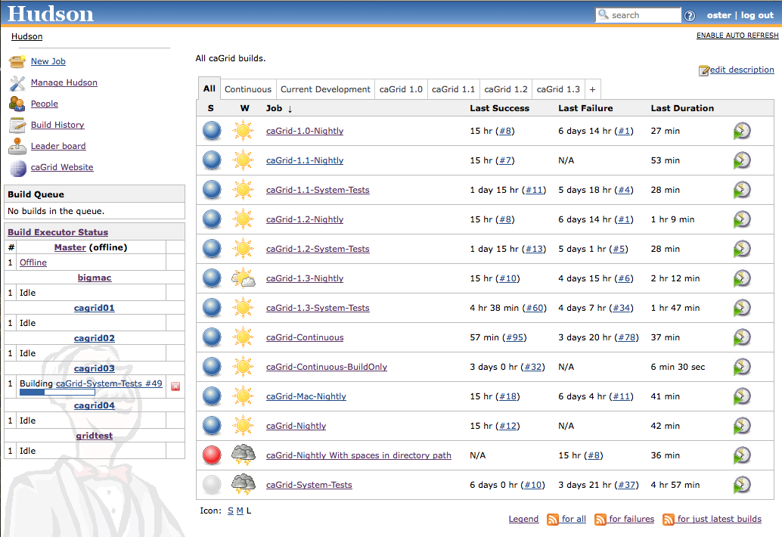
caGrid Quality Dashboard
caGrid automated testing now runs via a Hudson installation with a multi-platform build farm
Replaces previous more custom CruiseControl/DART installation
All historical releases are tested on a nightly basis
Current development continuously built and tested on multiple platforms
619 Unit tests
81 Integration/System tests
Detailed reports accessible via http://quality.cagrid.org/

Slide 45
Deployment Concerns / Options

Slide 46
Deployment Concerns
Hardware requirements are modest and flexible (software is pure Java)
Optional Hardware Security Module (HSM) support for Dorian and GTS impose some hardware constraints
VM/Cloud deployments have been used successfully
Short lived PKI is very time sensitive, so system clock synchronization is important (can be tricky on VMs)
Security infrastructure is important to “get right” and there are a lot of options (which can lead to complexity)
Services are loosely coupled and it needn’t be an “all or nothing” deployment
Deploying your own vs leveraging existing depends mostly on policy/governance/availability concerns

Slide 47
Deployment Process
caBIG Production grid and caGrid Training grid are nearly identical deployments
The process that was followed for these deployments is documented in a step by step fashion and available on the caGrid wiki
The training grid is publicly available and policy free
The production grid is independently managed in a 3-tier deployment, governed by policy, and moderated by a change control board
Numerous deviations are possibly however, including omitting some services (options in following slides)

Slide 48
Deployment Questions
Which services do I need / what use cases do I need to support?
What existing systems do I need to integrate with?
How federated is my community?
What policies/regulations need to be enforced?
What are my expected resource (computation, network, storage) needs?
How will it be managed overtime (upgrades, etc)?
Who will administer what services?

Slide 49
Security Bootstrapping
As grid security is PKI-based, the credentials used must be part of some Certificate Authority hierarchy
Current caGrid deployments use a self-signed CA, stored in a hardware security model
Only Grid Trust Services (GTS) are issued credentials from this CA
This creates the “root” for the trust fabric, and is the only part which must be manually distributed to participants
All other credentials are issued from CAs distributed and authorized via GTS
Third party CAs are possible to use
Discussed in detail here:
http://middleware.internet2.edu/pki07/proceedings/11-langella-federated-grid-trust-fabric.pdf

Slide 50
Deployment Best Practices
Deploying one service per container introduces some overhead, but makes it much easier to:
Keep consistent URLs for services over time as deployment topologies change
Upgrade/Deprecate individual services
Minimize impact of failures
Use standard ports to avoid firewall issues (80,443 or 8080,8443)
Create redundancy in administrative privileges to core services
Use of virtual hardware can help minimize downtime and ease upgrade processes
Make sure failsafe backups are in place for critical systems (e.g GTS, Dorian, etc)
Copy the existing deployment plan unless you need to deviate for a specific reason
Ensure system clock synchronization is always working
Use the caGrid installer to configure service containers
Use Tomcat unless you need JBoss; don’t use the Globus container

Slide 51
Metadata Services Deployment

Slide 52
Metadata Model Service
Required To:
Generate standard Data Service metadata
Annotate standard Service metadata
Invoked by:
Introduce metadata and data extensions
Invokes:
Configured external metadata registries (e.g. caDSR)
Index Service for registration
Can be omitted if:
Not leveraging model registration or semantic annotations

Slide 53
Global Model Exchange
Required To:
Register and discover data syntax (XML Schemas)
Invoked by:
Introduce metadata and data extensions
caGrid portal
Invokes:
Index Service for registration
Can be omitted if:
Schemas will only be loaded from the file system

Slide 54
Index Service
Required To:
Register and discover services
Invoked by:
All services to register themselves (can be disabled)
caGrid portal
Invokes:
All registered services
Can be omitted if:
All end points will be hardcoded

Slide 55
Business Activity Services Deployment

Slide 56
Federated Query Processor
Required To:
Perform federated joins and aggregations across Data Services
Invoked by:
caGrid portal
Invokes:
Index Service for registration
Target Data Services
CDS to retrieve client’s delegated credentials
Can be omitted if:
Not using data services, not doing joins, or joins will be done in application logic

Slide 57
Taverna Workflow Service
Required To:
Offload execution of Taverna workflows to the grid
Invoked by:
Taverna workbench plugin
Invokes:
Index Service for registration
Targeted services
Can be omitted if:
Not using Taverna or creating Scufl workflow

Slide 58
BPEL Workflow Service
Required To:
Offload execution of BPEL workflows to the grid
Invoked by:
Workflow UI
Invokes:
Index Service for registration
Targeted services
Can be omitted if:
Not using BPEL workflow

Slide 59
Security Services Deployment

Slide 60
Authentication Service
Required To:
Integrate an existing authentication mechanism (identity provider) with Dorian
Invoked by:
WebSSO
caGrid Portal
GAARDS UI
Introduce
Invokes:
Index Service for registration
External authentication framework (e.g. LDAP)
Can be omitted if:
Only using Dorian’s internal user management, or manually managing End Entity Certificates, or not using security

Slide 61
Credential Delegation Service
Required To:
Provide a third party the ability to perform work on your behalf
Invoked by:
WebSSO
GAARDS UI to administrate, and use
Introduce to use
FQP to retrieve client’s delegated credentials
Invokes:
Index Service for registration
GridGrouper for group-based delegation policies
Can be omitted if:
Not performing delegation, or in-container Globus delegation suffices, or not using security

Slide 62
Dorian
Required To:
Manage user and host credentials, federate authentication
Invoked by:
WebSSO to login
caGrid portal to login
GAARDS UI to administrate, and use
Introduce to login and use
Invokes:
Index Service for registration
Can be omitted if:
Manually managing End Entity Certificates or not using security

Slide 63
Grid Trust Service
Required To:
Manage federated trust environment, distribute trusted CAs and CRLs
Invoked by:
All service containers, clients, and web applications to retrieve current trust fabric
GAARDS UI to administrate, and use
Introduce to view trust fabric
Other GTSs as configured per trust federation
Invokes:
Index Service for registration
Other GTSs as configured per trust federation
Can be omitted if:
Manually managing trusted CAs and CRLs or not using security

Slide 64
Grid Grouper
Required To:
Manage groups or virtual organizations on the grid
Invoked by:
CDS to authorize use of group-based delegation policies
GAARDS UI to administrate, and use
Introduce to manage groups and create group-based authorization policies
Invokes:
Index Service for registration
Can be omitted if:
Not using group/role/attribute based authorization, or have no need to manage groups

Slide 65
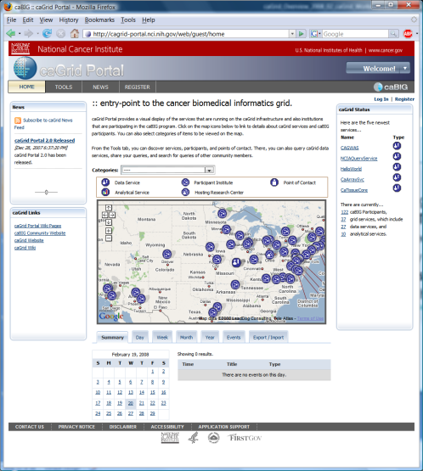
Project Resources and Communication
www.cagrid.org
Download Software
Documentation
Tutorials
Technical Paper and Presentations
FAQs
caGrid Knowledge Center
Knowledge Base
Forums
Enterprise Support
Community engagement
https://cabig-kc.nci.nih.gov/CaGrid/KC/index.php/Main_Page
caGrid GForge Home (project website)
Feature Requests
Bug Reports
Downloads / Source Repository
http://gforge.nci.nih.gov/projects/cagrid-1-0/
caGrid Portal (web portal)
http://cagrid-portal.nci.nih.gov/

Slide 66
caGrid Overview
caGrid / Novartis Workshop
Rockville, MD
June 22nd-26th , 2009

Slide 67
BACKUP SLIDES: caGrid 1.3 Changes

Slide 68
Deprecated Services
During the development of caGrid 1.3, the caGrid Team issued a request for comments on, and adopted, a Deprecation Policy. For details, see:http://cagrid.org/display/caGrid13/Deprecated+Services+and+APIs
After adoption of that policy, the caGrid 1.2 caDSR, caGrid 1.2 EVS, and caGrid 1.2 GME were retired:
caGrid 1.2 caDSR Service (based on caCORE 3.1)
Replaced by the caDSR 4.0 Data Service and the new caGrid 1.3 Metadata Model Service (MMS)
caGrid 1.2 EVS Service (based on caCORE 3.1)
Superseded by EVS 4.1 Grid Service
caGrid 1.2 GME Service
Replaced by new GME service
These retired services will continue to operate until Q2 2009, when the caCORE 3.1 API is decommissioned.
While still supported in caGrid 1.3, the BDT framework is deprecated

Slide 69
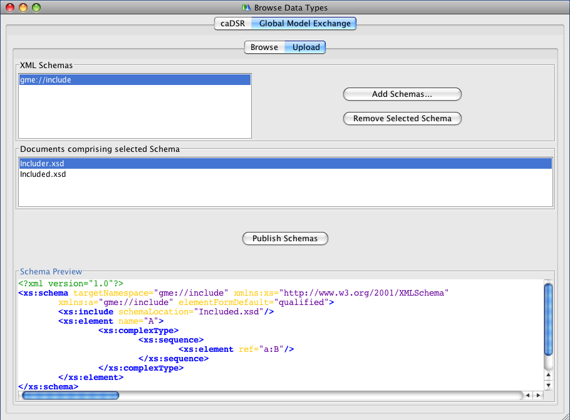
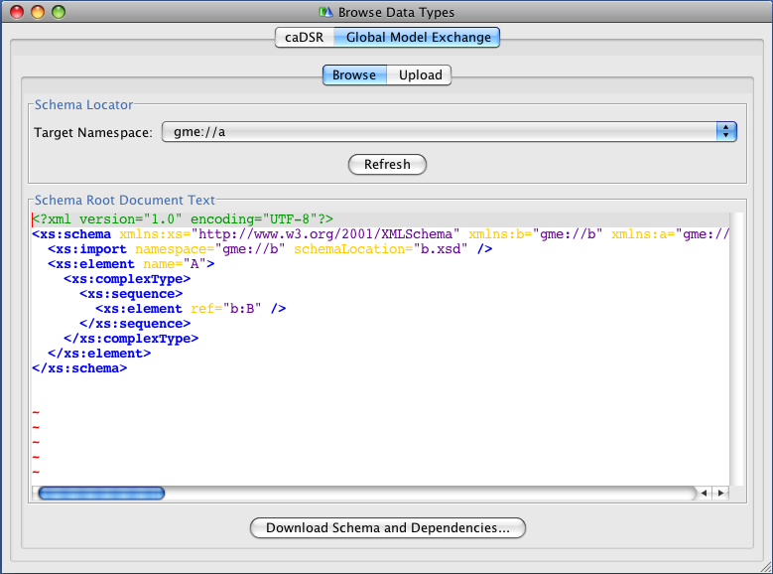
Gold Compatibility: Global Model Exchange (GME)
Completely re-implemented for caGrid 1.3 to address numerous feature requests and limitations
Now a fully managed Introduce service (previously was just a wrapper to the Mobius GME software)
Leverages…
Spring for configuration and data patterns
Hibernate for data persistence
Castor for custom domain model serialization
Xerces for 100% XML Schema support
Improved Introduce integration
Selected new features:
Now supports XML Schemas with includes, redefines, cyclic imports, arbitrary namespaces
Schema Deletion
MySQL 5 support

Slide 70
Gold Compatibility: Metadata Model Service (MMS)
As the caDSR Grid service was retired, its functionality was replaced with the caDSR Data Service and the new MMS
MMS provides the metadata-oriented functionality, such as generating Domain Models and semantically annotating Service Metadata
Simple migration path from caDSR grid service to MMS
Is a generic service which provides the ability to integrate any external metadata registry as a metadata source for annotations
Leverages Spring for deploy-time configuration
Default implementation uses the production caDSR as its source, but (multiple) other registries can be added to the same service
Not dependent on a particular model or software version of the caDSR
Makes full use of the new caDSR XML Schema namespace binding annotations
Fully integrated into Introduce for visualizing Domain Models and annotating metadata instances

Slide 71
Gold Compatibility: Index Service
Working with the Globus MDS team (ISI), the Index Service implementation was completely redesigned for better memory usage and performance
Leverages Apache Xindice XML Database for “out of memory” storage and query (previous version was all Heap-based).
Added multi-threading for metadata polling to greatly increase registration throughput
Slight change in behavior, but 100% backwards compatible to Discovery and Advertisement clients
Production Index Service now running smoothly with 130+ registrations
Local tests scaled up into the thousands
Modified default Introduce-generated advertisement settings to reduce the load on the Index Service while maintaining the same response time

Slide 72

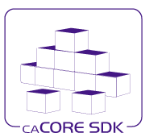
caCORE SDK Integration
Created Data Service Introduce extension for SDK 4.1.1
Upgraded Introduce XMI-based schema generation to leverage SDK 4.1.1
Shared libraries between SDK and caGrid:
Common CQL Processor for SDK and Data Services
Common Testing of caGrid and SDK

Slide 73
Data Services: Federated Query Processor (FQP)
Added configurable query execution parameters to allow control over behavior in the face of failure
Ability to return partial results, specify retries, or fail
Added new results metadata which gets updated during query execution containing:
Overall processing status (waiting, working, done, etc)
Details of each target service (range of data in results, faults, etc)
Support WS-Notification
Client can be notified of changes in execution status for example
Support for delegation via integration with Credential Delegation Service (CDS)
Client can use CDS to delegate to FQP, and request FQP to query data services using the delegated credential
Support for using caGrid Transfer to obtain query results
Performance enhancements, included multi-threaded queries

Slide 74
Introduce Toolkit: Security-related improvements
Created authorization extension framework for plugging in arbitrary authorization components
Migrated Grid Grouper and CSM Authorization to authorization extensions
Created an authorization extension to do “authentication only” (i.e. check that the user presented a credential)
Greater ability for client to control use of credentials
Clients now have a preferAnonymous operation which can be used to override service suggestions
Greater clarity of effect of options in GUI for security settings
Integrated GAARDS UI components to Introduce (e.g. ability to login, request credentials, etc)

Slide 75
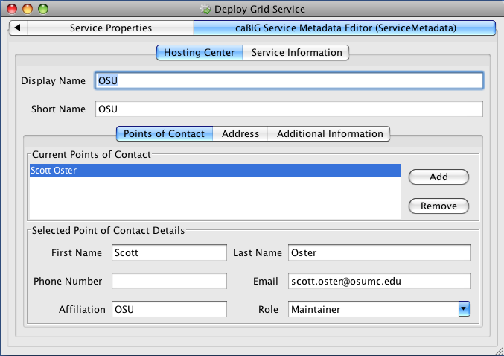
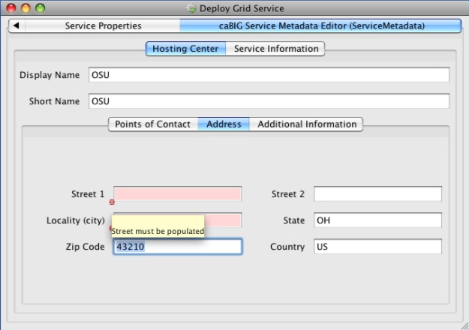
Introduce Toolkit: Other improvements
Added deploy-time validation extension framework
caGrid metadata validator ensures proper metadata is filled out or prevents deployment (e.g. point of contact, host information)
Developed Service Upgrade Support for previous versions
1.1 -> 1.3
1.2 -> 1.3
No Updater for 1.0 -> 1.3

Slide 76
Security: Authentication Enhancements
Addition of Authentication Profiles, adding support for authentication beyond just “username/password”
Support for one-time passwords profile included in this release
Authentication Service refactored to support; Dorian added implementation
Ability to securely discover Trusted Identity Providers
Dorian now maintains authentication service metadata (URL and identity) for its IDPs
Clients can discover Authentication Services for trusted IDPs by asking Dorian or viewing its new metadata exposing this information
GAARDS UI now leverages this

Slide 77
Security: WebSSO Enhancements
Created an Acegi client
Out of the box support for Liferay
Updated to newer CAS versions (server:3.2.2, client:3.1.1)
Implementation of Single Sign-Out
A user logging off of one application will be logged off of all participating in the SSO session
Added support for Authentication Profiles and discovery of Authentication Services via Dorian’s trusted IDP metadata
Created comprehensive integration tests which deploy and test the WebSSO server, sample applications, Dorian, and CDS

Slide 78
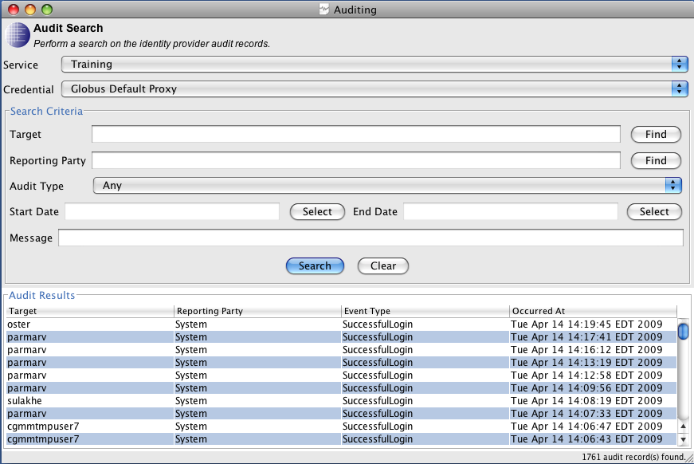
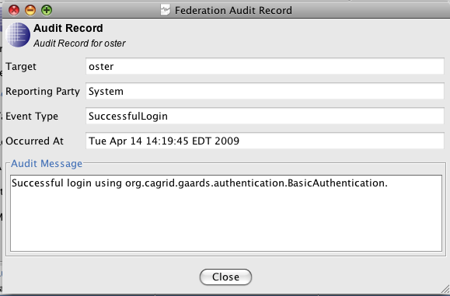
Security: Dorian
Service now leverages Spring for configuration
Implementation of Authentication Profiles and IDP metadata
Move from issuing Proxy Certificates to Short-Term Certificates
Added comprehensive auditing to service and ability to access audit records over the service interface (as an admin)
GAARDS UI support for querying and viewing audit records

Slide 79
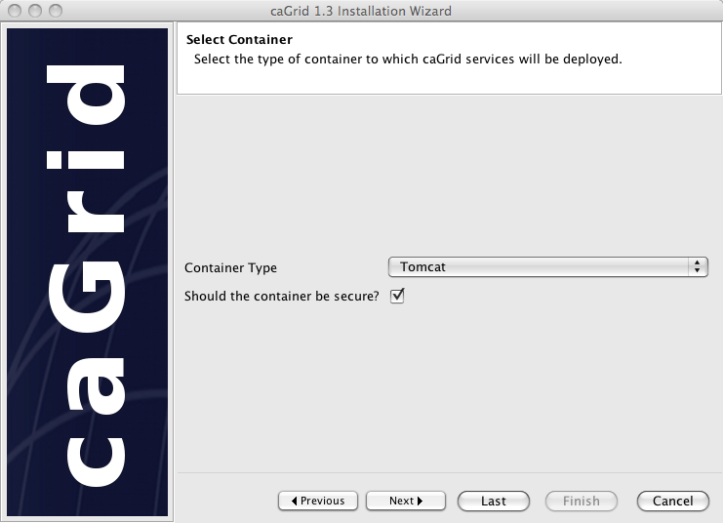
caGrid 1.3 Installer
Refactored and refocused on desktop deployment (most common pattern)
Does not deploy/configure services anymore
Installs: prerequisites, configures caGrid, and configures containers (current CBIIT technology stack)
Added support for Jboss
Can launch GAARDS UI to request credentials directly during installation
No longer necessary to stop and start installation for secure container configuration
Can easily be used to retarget a container to a new grid (change target grids and install new credentials)
Better support for custom target grids
Other usability improvements such as avoiding re-downloading, setting execute permissions on scripts, minimizing steps, etc

Slide 80
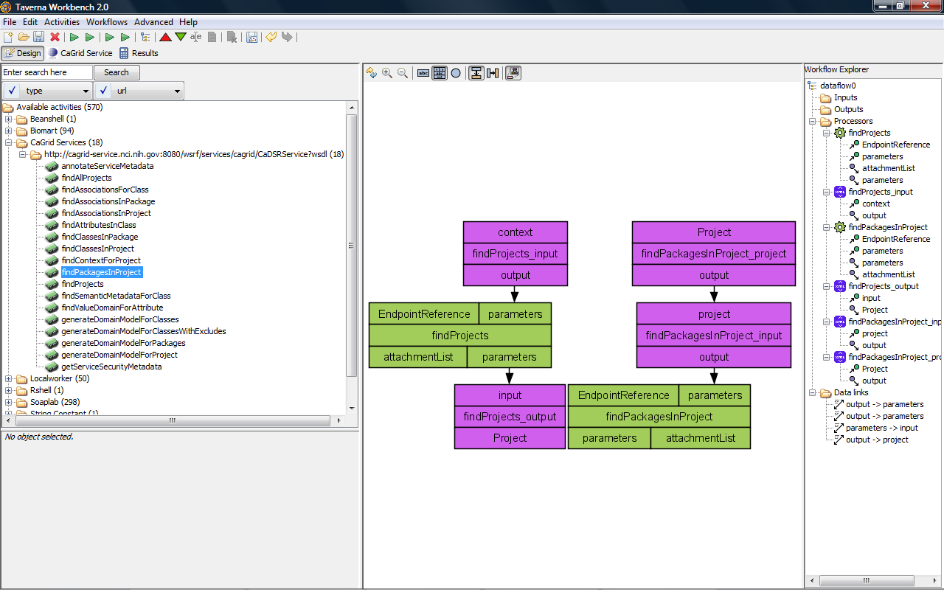
Workflow: Taverna
Added a new service Taverna Workflow Factory Service for executing Scufl (Simple Conceptual Unified Flow language) workflows, which is the language of the Taverna Workbench
Leverages the same service infrastructure as the existing BPEL-based workflow service
Updated client support to Taverna 2

